Slide 1

The Coulomb Pack
Nikola, Justin, Varouzan, DongKyu

Slide 2
Webpage
https://nikopj.github.io/Traveler-SCD/

Slide 3
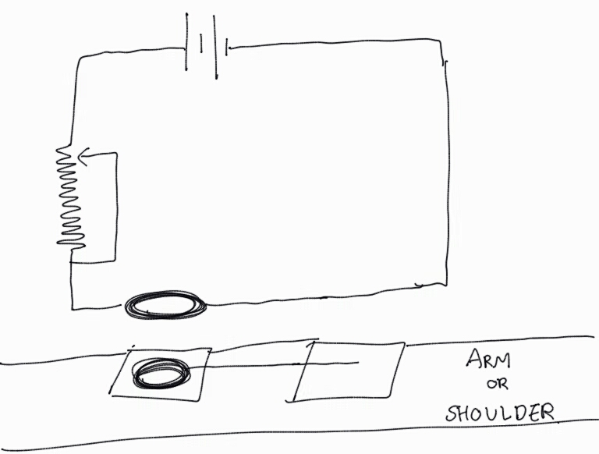
Prototype Planning 1 – Technical

Slide 4
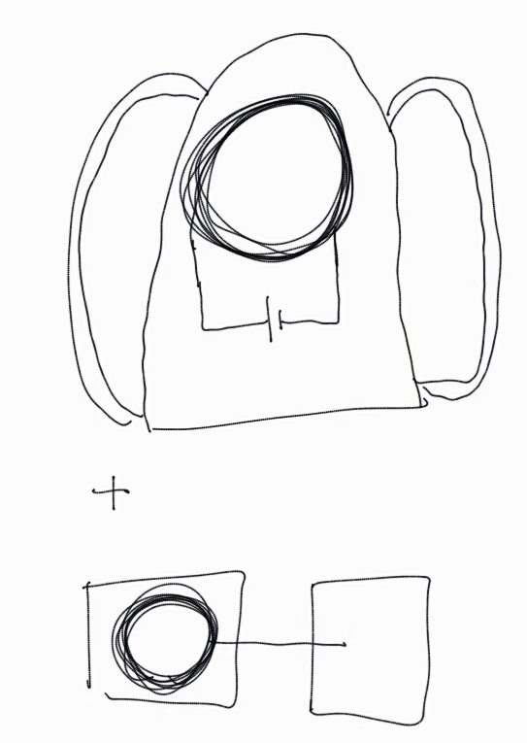
Prototype Planning 2 – The Product

Slide 5

Next Steps

Slide 6
Thank you

